Slide 1


Password-Based Lock System
19CCE201 Microcontrollers and Interfacing Techniques
Computer and Communication Engineering
Semester III – 2020-24 Batch
This Photo by Unknown author is licensed under CC BY.

Slide 2
CCE Team 9
Name | Roll Number
Malavika Menon T | CB.EN.U4CCE20031
Manoj Parthiban | CB.EN.U4CCE20032
Narendran S | CB.EN.U4CCE20036
Santosh | CB.EN.U4CCE20053

Slide 3

Introduction
In the present scenario of the world, security is a major concern for all, and the security problem is being faced by every person.
The usual means of securing anything is through mechanical locks, which operate with a specific key or a few keys; but, for locking a large area many locks are necessary.
However, conventional locks are heavy and do not offer the desired protection as they can be easily broken down by using some tools. Therefore, security breaching problems are associated with mechanical locks.
However, to decide the electronic-based locking system problems that are associated with the mechanical locks. Nowadays, many devices’ operations are based on digital technology.
For example, a token-based digital identity device. Here we will see Password Based Door Open System Using LPC2148.

Slide 4
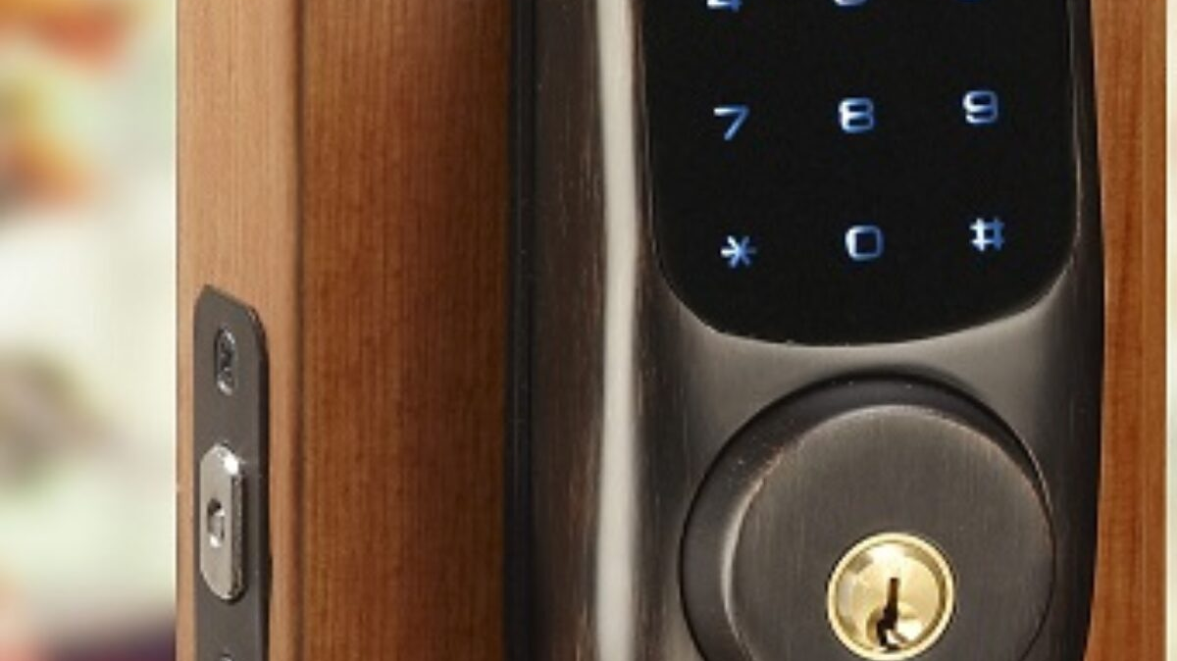
Project Description
An automatic lock system consists of electronic control assembly which controls the output load through a password. This output load can be a motor or a lamp or any other mechanical/electrical load.
Here we develop an electronic code lock system using ARM7(LPC2148), which provides control to the actuating the load. It is a simple embedded system with input from the keypad and the output being actuated accordingly.
This system demonstrates a password-based door lock system wherein once the correct code or password is entered, the door is opened, and the concerned person is allowed access to the secured area.
Again, if another person arrives it will ask to enter the password. If the password is wrong then door would remain closed, denying the access to the person.

Slide 5
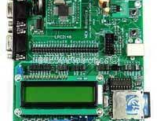
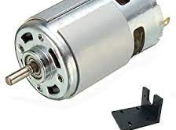
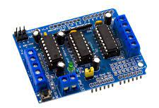
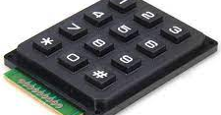
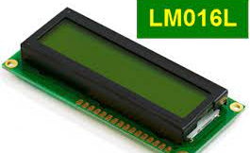
Components Required
Hardware - LPC2148 Development Board, LCD Module – LM016L, 4*3 Keypad – Phone, DC Motor and L293D (Motor Driver)
Software - Keil µVision4 IDE and Proteus 7 Professional (Labcenter Electronics)

Slide 6
Circuit Diagram Representation
LCD | DC Motor (Motor Driver) | Keypad
RS – P0.2 | Input 1 – Port 0.16 | R1 – P1.16
RW – GND | Input 2 – Port 0.17 | R2 – P1.17
EN – P0.3 | Enable 1 – P0.18 | R3 – P1.18
Data Lines – P0.4 to P0.7 (4 Bit Mode) |  | R4 – P1.19
 |  | C1 – P1.20
 |  | C2 – P1.21
 |  | C3 – P1.22

Slide 7
Working Explanation
The project consists of blocks as a microcontroller, a keypad, an LCD, a DC motor, and a motor driver.
The keypad is an input device which helps to enter a password to open the door. It gives the entered code signals to the microcontroller. LCD is used to indicating devices for displaying the information.
It will ask for the Password. By default, password is “1234”. It will open the door and again will close if we enter the correct password. Otherwise, it won’t open the door at all.
The DC motor moves the door to open and close and the motor driver drives the motor after receiving the code signals from the microcontroller.

Slide 8
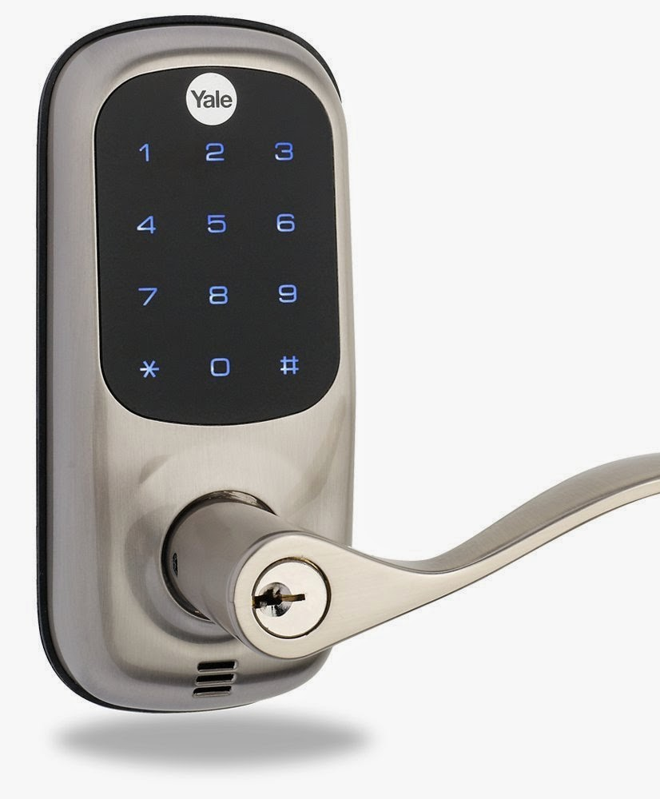
Application
These can be used in various rooms like seminar hall, conference room, and study rooms in college.
The password detector can be used to automate the door locking process, so the user need not carry the door lock keys along with them, they need to just remember the password and use it later to open the door.
They add an excellent personalized security.
This Photo by Unknown author is licensed under CC BY-SA-NC.

